Slide 1
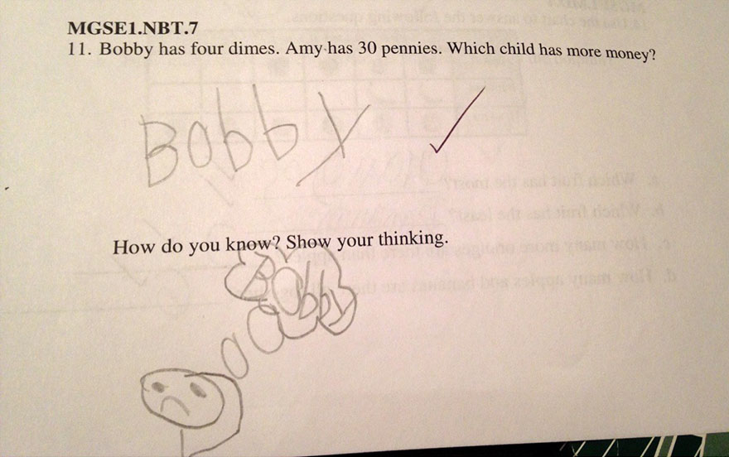
Experimental Design: Stratification
ENTMLGY 6702 Entomological Techniques and Data Analysis

Slide 2
Learning objectives
Evaluate pros and cons of stratification in experimental design
Compare and contrast experimental designs
Understand how components of an ANOVA can be influenced by design choice

Slide 3

Completely randomized design
In a completely randomized design, we assigned treatments to experimental units randomly.
A
B
C
single plant
Sampling universe (e.g., farm)

Slide 4
Randomized complete block (RCB)
…but if we expect variation in our response to be influenced by location, time, shipment, etc…
…we can use blocking to account for that variation.
Treatments are assigned to blocks, and THEN assigned randomly to experimental units.
A
B
C
single plant
Sampling universe (e.g., farm)

Slide 5
RCB simplified
Block 1 | Block 2 | Block 3 | Block 4
D | D | A | C
B | C | D | B
C | A | C | A
A | B | B | D

Slide 6
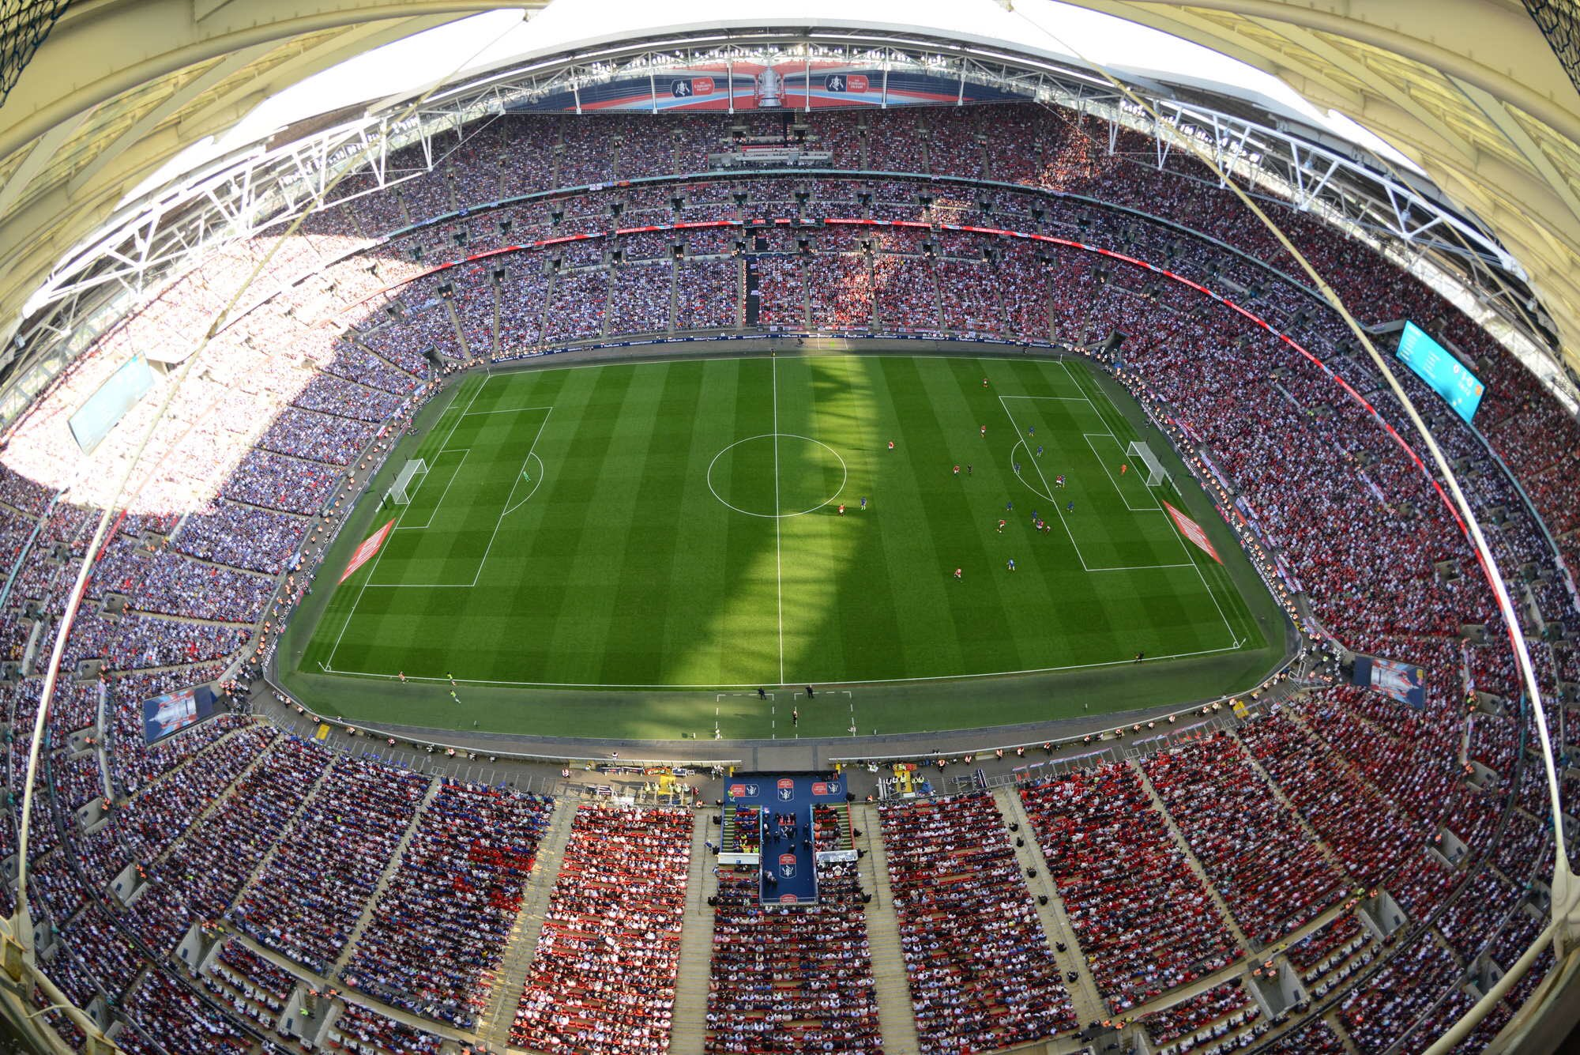

Slide 7
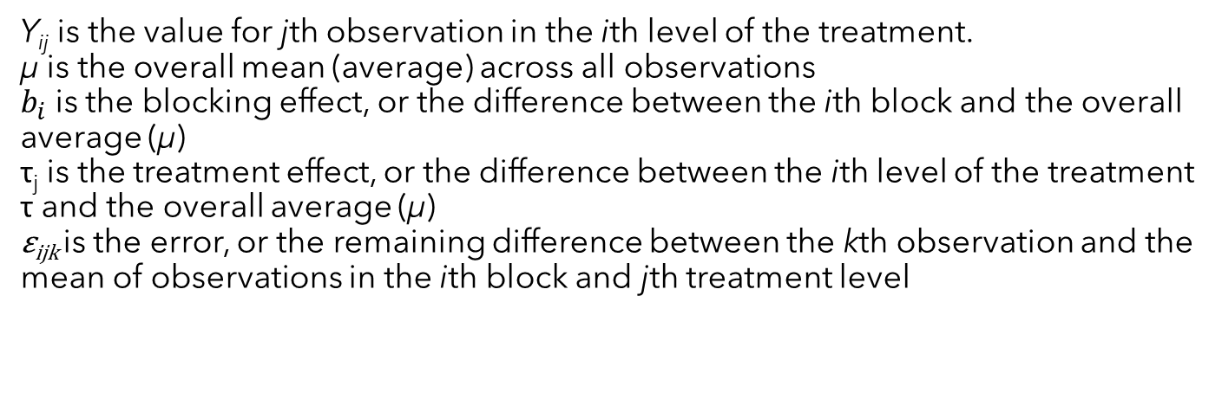
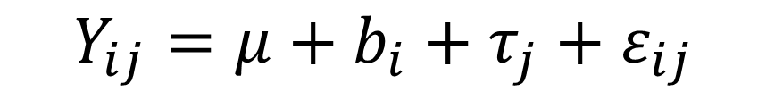
Linear model for RCB
$$Y_{ij}=μ+b_{i}+τ_{j}+ε_{ij}$$
Y_{ij} is the value for jth observation in the ith level of the treatment.
µ is the overall mean (average) across all observations
$b_{i}$is the blocking effect, or the difference between the ith block and the overall average (µ)
τ_{j} is the treatment effect, or the difference between the ith level of the treatment τ and the overall average (µ)
ε_{ijk} is the error, or the remaining difference between the kth observation and the mean of observations in the ith block and jth treatment level

Slide 8
Balanced incomplete block design (BIBD)
Not all treatments appear in each block.
λ_{ii’}=2=number of times treatment i and i' occur together.
Block 1 | Block 2 | Block 3 | Block 4
D |  | D
 | C | C | B
C | A | B | A
A | B |  | D

Slide 9
Unbalanced incomplete block design
Block 1 | Block 2 | Block 3 | Block 4
 | D | A
 |  |  | B
C |  | C
A | B |  | D

Slide 10
Stratification in experimental design
The bottom line: You are trying to increase precision by experimentally and statistically partitioning out variance that is not attributable to your treatments.

Slide 11
Activity (discussion)
Take a moment to think about your (potential) project.
What is the response variable?
What is at least one predictor (treatment)?
Are there any nuisance variables? How will or how did you account for them?
If you don’t have a study with response and predictors, try to think of and report a similar study that might fit these criteria.

Slide 12
Randomized complete block
Blocks can be locations in space, points or intervals of time, groups of individuals, etc.
Advantages
Can increase precision compared with completely randomized design
No limit to the number of treatments and blocks
Analysis is straightforward
Disadvantages
If blocking is not effective, you lose precision AND degrees of freedom
More treatments → harder to include them all in a block (e.g., more physical space incorporated could lead to more heterogeneity)
We assume no interaction between blocks and treatments (i.e., treatments are not having different effects on the response variable based on the block in which they occur). If that’s happening, inference may be biased.

Slide 13
Activity
Source | df | SS | MS
Treatment | 1 | 78 | 78
Error | 4 | 74 | 18.5
Total | 5 | 152 | -
Pretend we added x blocks to the design and got the below ANOVA table.
How many blocks did we add?
Calculate a new F-ratio for our treatment by filling in the table.
Source | df | SS | MS
Treatment | 1 | 78 | 78
Block | 1 |  | 59
Error
Total | 5 | 152 | -

Slide 14
ANOVA
Source | df | SS | MS
Treatment | 1 | 78 | 78
Block | 1 | 59/1 | 59
Error | 3 | 74-59=15 | 5
Total | 5 | 152 | -
New F-ratio:
F_{1,3}=78/5 = 15.60
We added two blocks, which (in a perfect world), accounts for some of that residual variation. The unexplained variation went down, so the denominator in our F-ratio went up.
If our blocks do a bad job of soaking up that variation, we are burning degrees of freedom!

Slide 15
Randomized complete block
Account for a source of variation
Latin squares
Account for two sources of variation (= block in two directions)
Split plots
One of your treatments is difficult or expensive to vary. Establish a whole plot and subplot.

Slide 16
Latin square
Randomized complete block
Latin square
(block in two directions)
Block 1 | Block 2 | Block 3 | Block 4
B | C | D | A
A | D | C | B
B | D | A | C
C | B | A | D
B | D | C | A
D | C | A | B
C | A | B | D
A | B | D | C

Slide 17
Latin square
Advantages:
Account for multiple (two) nuisance factors
Disadvantages:
The number of treatments needs to equal the number of levels of blocks
Assumes no interactions between the rows and columns (=blocks) or between the treatment and rows/columns

Slide 18
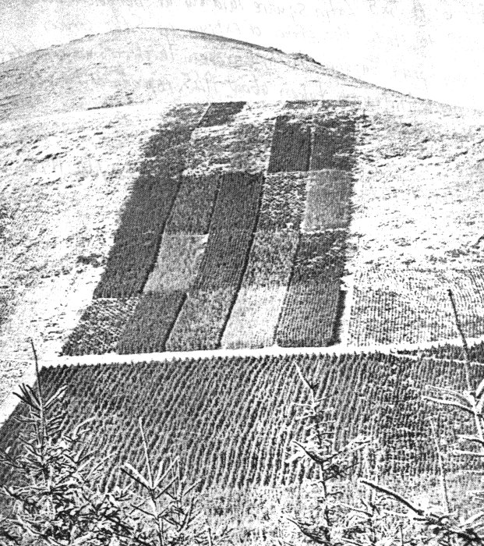
Latin square
Example: a 5 ×5 forestry experiment in Beddgelert in Wales, to compare varieties of a tree species; designed by Fisher, laid out in 1929, and photographed in about 1945.
1 | 2 | 3 | 4 | 5
5 | 3 | 1 | 2 | 4
2 | 5 | 4 | 3 | 1
4 | 1 | 2 | 5 | 3
3 | 4 | 5 | 1 | 2

Slide 19
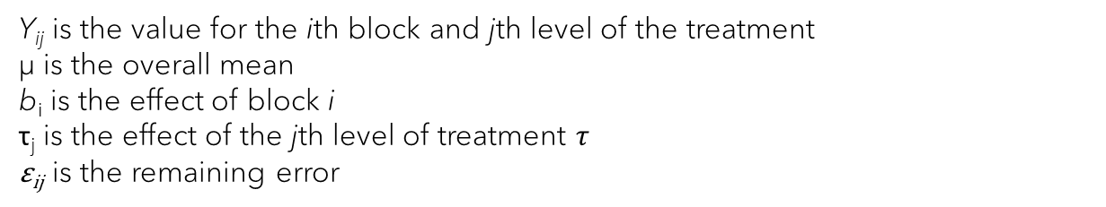

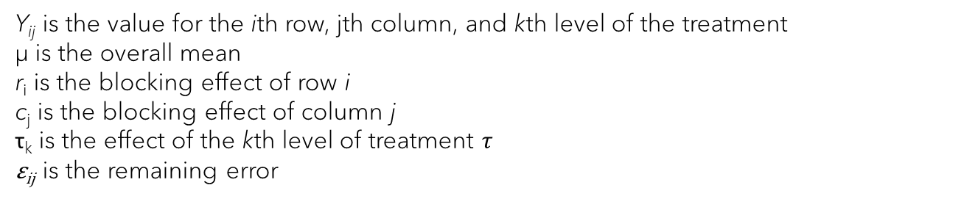
Linear models
Randomized complete block
$$Y_{ij}=μ+b_{i}+τ_{j}+ε_{ij}$$
Y_{ij} is the value for the ith block and jth level of the treatment
µ is the overall mean
b_{i} is the effect of block i
τ_{j} is the effect of the jth level of treatment $τ$
ε_{ij} is the remaining error
Latin square
$$Y_{ijk}=μ+r_{i}+c_{j}+τ_{k}+ε_{ijk}$$
Y_{ij} is the value for the ith row, jth column, and kth level of the treatment
µ is the overall mean
r_{i} is the blocking effect of row i
c_{j} is the blocking effect of column j
τ_{k} is the effect of the kth level of treatment $τ$
ε_{ij} is the remaining error
Note: I’ve suppressed the subscript identifying individual observations

Slide 20
Split plot
Use when you are interested in two independent variables, but one of them is challenging to vary (e.g., you are limited by space, time, money, etc.).
Assign levels of the “hard-to-vary” factor to entire plots (= whole plots)
Within each whole plot, randomly assign levels of the other factor to your experimental units (= subplots).
Advantages: Increase in precision on subplot factors when the experiment “works “ (= the variation is decreased among subplots grouped into whole plots); cheaper
Disadvantages: Loss in precision of whole plot factor. Difficult to create/design and can be difficult to analyze.

Slide 21


Split plot example
We are interested in the effects of site preparation (presence vs. absence of prescribed fire) and herbicide treatment (none vs. spot treatment) on hardwood regeneration (germinated oak seeds per m²)
Randomize at each step (including, if need be, by randomized blocking)
Whole plot:
Subplots

Slide 22
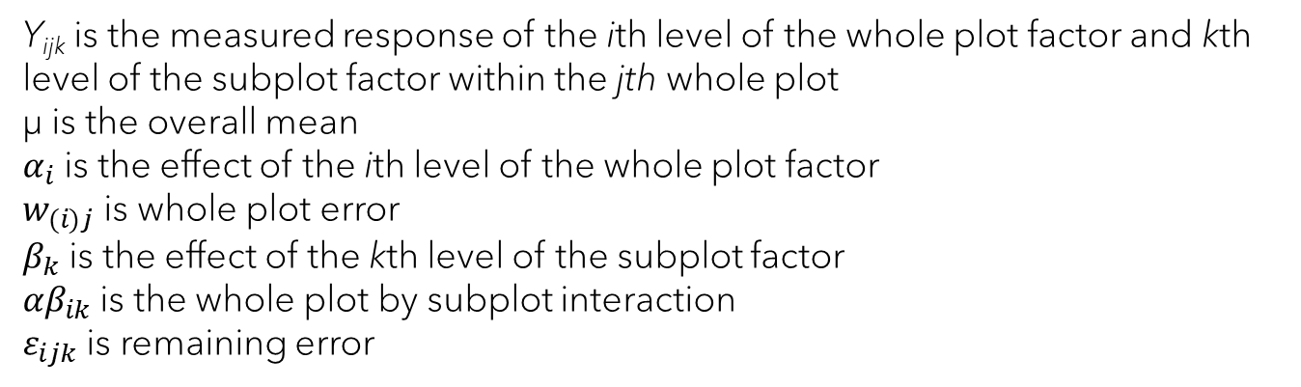
Linear model for split plot
$$Y_{ijk}=μ+α_{i}+w_{(i)j}+β_{k}+{αβ}_{ik}+ε_{ijk}$$
Y_{ijk} is the measured response of the ith level of the whole plot factor and kth level of the subplot factor within the jth whole plot
µ is the overall mean
$α_{i}$is the effect of the ith level of the whole plot factor
$w_{(i)j}$ is whole plot error
$β_{k}$ is the effect of the kth level of the subplot factor
${αβ}_{ik}$ is the whole plot by subplot interaction
$ε_{ijk}$is remaining error
Note: I’ve suppressed the subscript identifying individual observations

Slide 23
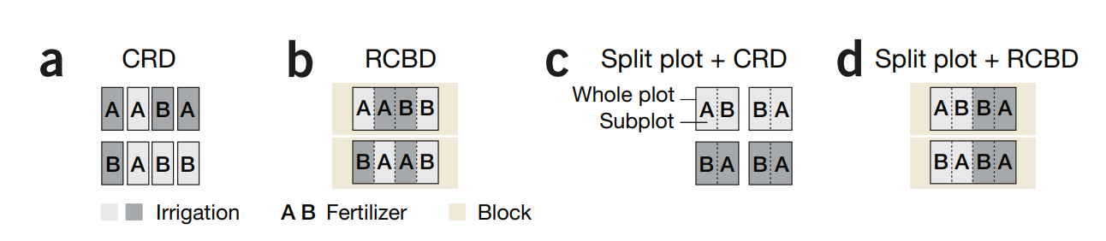
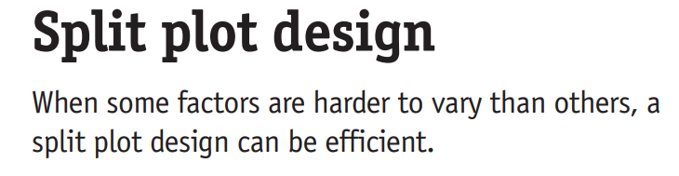


Split plot - comparisons

Slide 24
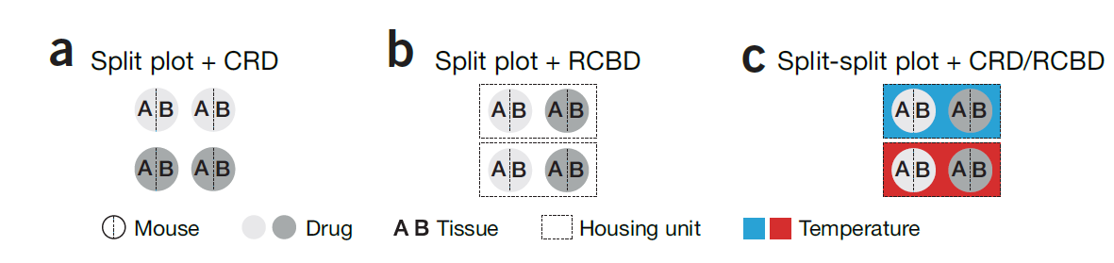
Split plot

Slide 25
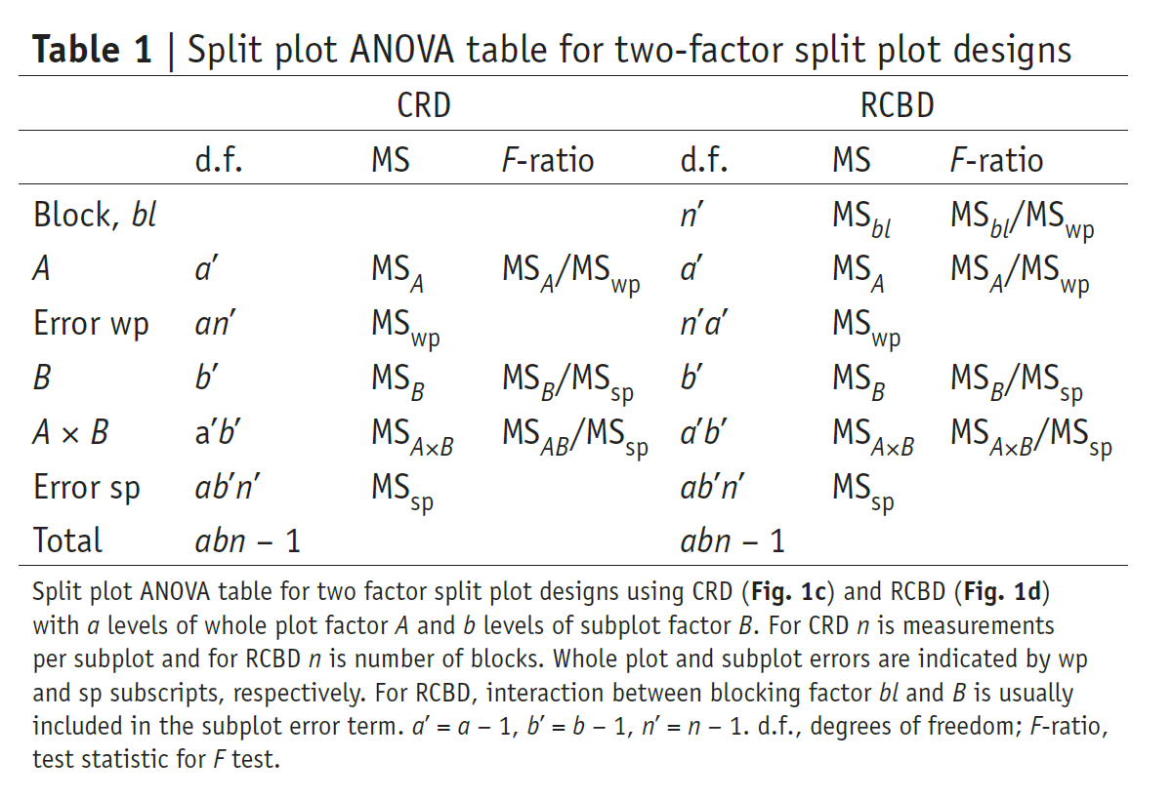
F-ratios in split plot designs

